Slide 1
Building Movie Review Website II
Week 08.

Slide 2
Objectives
Demonstrate how to build the basic architecture of a web application based on a Movie Review website;
Demonstrate how to build the web pages of a Movie Review website.

Slide 3
Tools Required
Visual Studio Code
Node.js
Browser
Google Chrome (recommended)
Mozilla Firefox

Slide 4
Creating the View…Continue

Slide 5
Creating Movie Details Modal Window
We will now build the Movie Details modal window where we will continue to use the Bootstrap modal class.
Watch the demo here
Let’s look at the wireframe for this in the next slide.

Slide 6
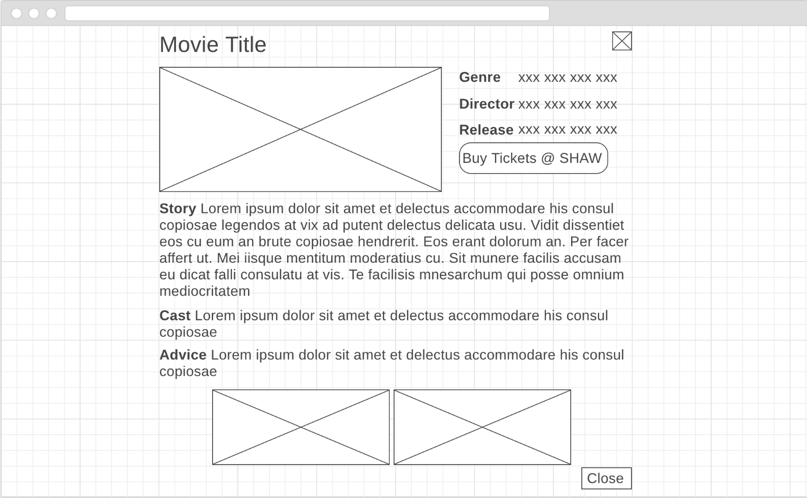
Wireframe – Movie Details
Movie Title.
Image icon to close modal window when clicked.
Image of movie poster.
Button to launch ticket purchase page in SHAW website in new browser tab when clicked.
Button to close modal window when clicked.
Movie Trailer 1 from YouTube
Movie Trailer 2 from YouTube
Notes:
https://wireframe.cc/Xj6ybf

Slide 7
Creating Movie Details Modal Window - movies-modal.html
<!-- this is a structure of Bootstrap Modal -->
<div class="modal fade" id="movieModal" tabindex="-1" role="dialog">
<div class="modal-dialog modal-lg" role="document">
<div class="modal-content">
<div class="modal-header bg-dark text-center">
<h3 class="modal-title text-light" id="movieTitle">Modal title</h3>
<button type="button" class="close bg-light" data-dismiss="modal">
<span>&times;</span>
</button>
</div>
<div class="modal-body">
<div class="row text-center">
<div class="col-5">
<img class="img-fluid img-thumbnail" id="moviePoster">
</div>
<div class="col-7">
<table class="table table-hover table-responsive table-sm">
<tr>
<td><span class="badge badge-pill badge-dark font-weight-bold">Genre</span></td>
<td id="genre"></td>
</tr>
<tr>
<td><span class="badge badge-pill badge-dark font-weight-bold">Director</span></td>
<td id="director" style=' width: 200px; word-break: break-all; word-wrap: break-word;'></td>
</tr>
<tr>
<td><span class="badge badge-pill badge-dark font-weight-bold">Release</span></td>
<td id="release"></td>
</tr>
<tr>
<td colspan="2"><button type="button" class="btn btn-warning" id="buy" onClick="buyTicket()">Buy Tickets @ SHAW</button></td>
</tr>
</table>
</div>
</div>
<div class="col-xs-12 px-3"><span class="badge badge-pill badge-dark font-weight-bold float-left">Story </span>
<p id="story"></p>
</div>
<div class="col-xs-12 px-3"><span class="badge badge-pill badge-dark font-weight-bold float-left">Cast </span>
<p id="cast"></p>
</div>
<div class="col-xs-12 px-3"><span class="badge badge-pill badge-danger font-weight-bold float-left">Advice </span>
<p id="advice"></p>
</div>
<div class="col-xs-12 px-3 text-center">
<iframe src="" frameborder="0" allowfullscreen id="trailer1"></iframe>
<iframe src="" frameborder="0" allowfullscreen id="trailer2"></iframe>
</div>
<div class="modal-footer">
<button type="button" class="btn btn-secondary bg-dark" data-dismiss="modal">Close</button>
</div>
</div>
</div>
</div>
</div>

Slide 8
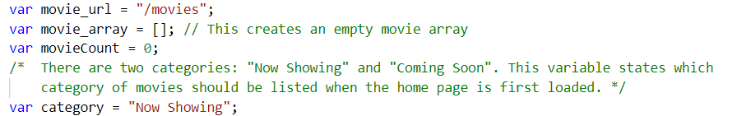
Creating Movie Details Modal Window
Add a new variable in the app.js file called currentIndex and set it to 0 as shown below.
var currentIndex=0;

Slide 9
Creating Movie Details Modal Window
Add the codes on the right into your movies.js file.
The showMovieDetails() function assigns the relevant movie data to the HTML elements base on their id.
The buyTicket() function opens up a new window/tab and goes to the URL which is the value of the buy attribute of each movie. (check the movie data in JSON format in the previous PowerPoint)
//This function is to display the individual movies details
//whenever the user clicks on "See More"
function showMovieDetails(element) {
var item = element.getAttribute("item");
currentIndex = item;
document.getElementById("movieTitle").textContent = movie_array[item].title;
document.getElementById("moviePoster").src = movie_array[item].poster;
document.getElementById("genre").textContent = movie_array[item].genre;
document.getElementById("director").textContent = movie_array[item].director;
document.getElementById("cast").textContent = movie_array[item].cast;
document.getElementById("release").textContent = movie_array[item].release;
document.getElementById("advice").textContent = movie_array[item].advice;
document.getElementById("story").textContent = movie_array[item].story;
document.getElementById("trailer1").src = movie_array[item].video1;
document.getElementById("trailer2").src = movie_array[item].video2;
}
//This function opens a new window/tab and loads the
//particular movie in the cinema website
function buyTicket() {
window.open(movie_array[currentIndex].buy, "_blank");
}

Slide 10

Test the Movie Details Modal Window
Reload the index.html page and hover on one of the movie icons. Click on the “See More” button and the modal window should appear as shown.
When you click on this button, a new window or tab should appear loading the cinema website to purchase ticket as shown on the next slide.

Slide 11
Adding Comments Modal Window
Comments are also displayed in modal window.
Let’s take a look at the wireframe design that displays Comments on the next slide.

Slide 12
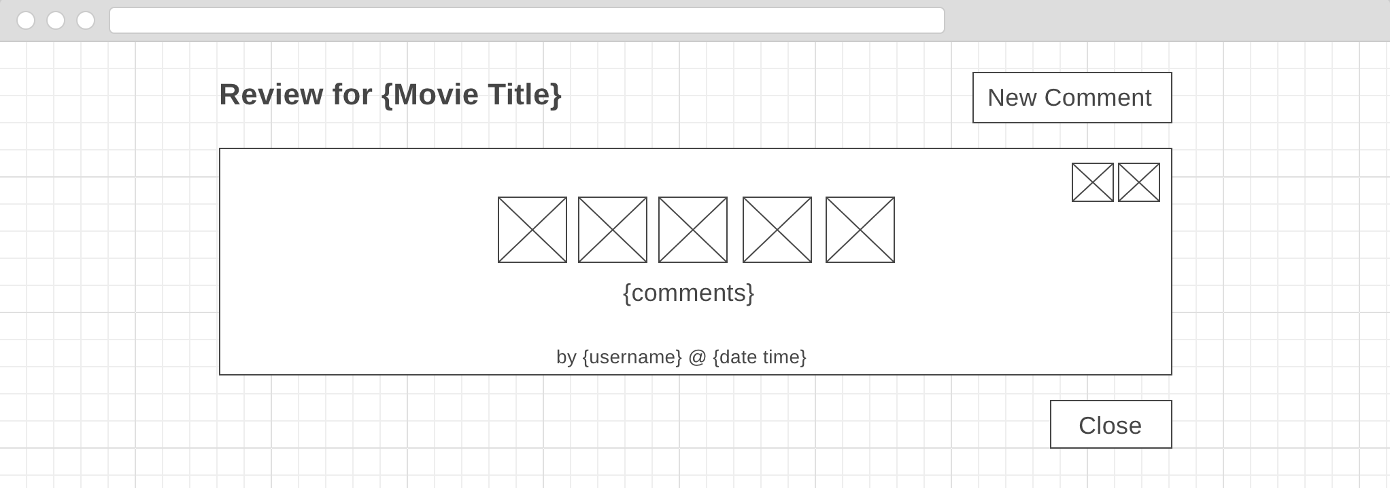
Wireframe - Comments
Text to display movie title.
Button that will open a new Comment modal window for editing when clicked.
Delete icon using fontawesome that will delete this comment when clicked.
Five image icons that indicates the rating. Rating is based on a mixture of coloured and black-and-white images. Images will not be displayed if no rating given.
Edit icon using fontawesome that will open a Comment modal window for editing when clicked.
Text to display user comments. If no comment, display “No review yet. Create one now.”
Text to display username/nickname, and date and time the comment is made. If no comment, whole line will not be shown.
Button that will close the modal window when clicked.
Notes:
https://wireframe.cc/RfBRRH

Slide 13
Adding Comments Modal Window - comments-modal.html
We will starting with creating the modal window in HTML.
<!-- this is a structure of Bootstrap Modal -->
<div class="modal fade" id="commentModal" tabindex="-1" role="dialog">
<div class="modal-dialog modal-lg" role="document">
<div class="modal-content">
<div class="modal-header bg-dark text-center">
<h5 class="modal-title text-light" id="review">Review</h5>
<button type="button" class="btn btn-primary" id="newComment" data-toggle="modal" data-target="#newCommentModal" data-dismiss="modal" onClick="newComment()">New Comment</button>
</div>
<div class="modal-body">
<div id="emptyComment">No review yet. Create one now</div>
<div class="row px-5" id="commentBody"></div>
<div class="modal-footer">
<button type="button" class="btn btn-secondary bg-dark" data-dismiss="modal">Close</button>
</div>
</div>
</div>
</div>
</div>

Slide 14
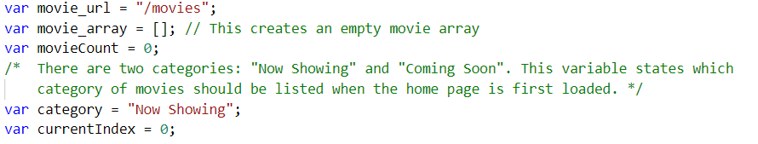
Adding Comments Modal Window
To display Comments, we will need to use the web service for retrieving Comments
In the app.js file, add new variables as shown in the highlighted codes below.
var comment_url = "/comments";
var comment_array = []; // This creates an empty comment array

Slide 15
Adding Comments Modal Window - comments.js
function fetchComments() {
var request = new XMLHttpRequest();
request.open('GET', comment_url, true);
//This command starts the calling of the comments api
request.onload = function() {
//get all the comments records into our comments array
comment_array = JSON.parse(request.responseText);
console.log(comment_array);
};
request.send();
}
Console.log to see if we are successful in getting back the data
This function is to consume the web api endpoint that will return the comments data in json format. Remember to call this function fetchComments() in the getMovieData()function

Slide 16
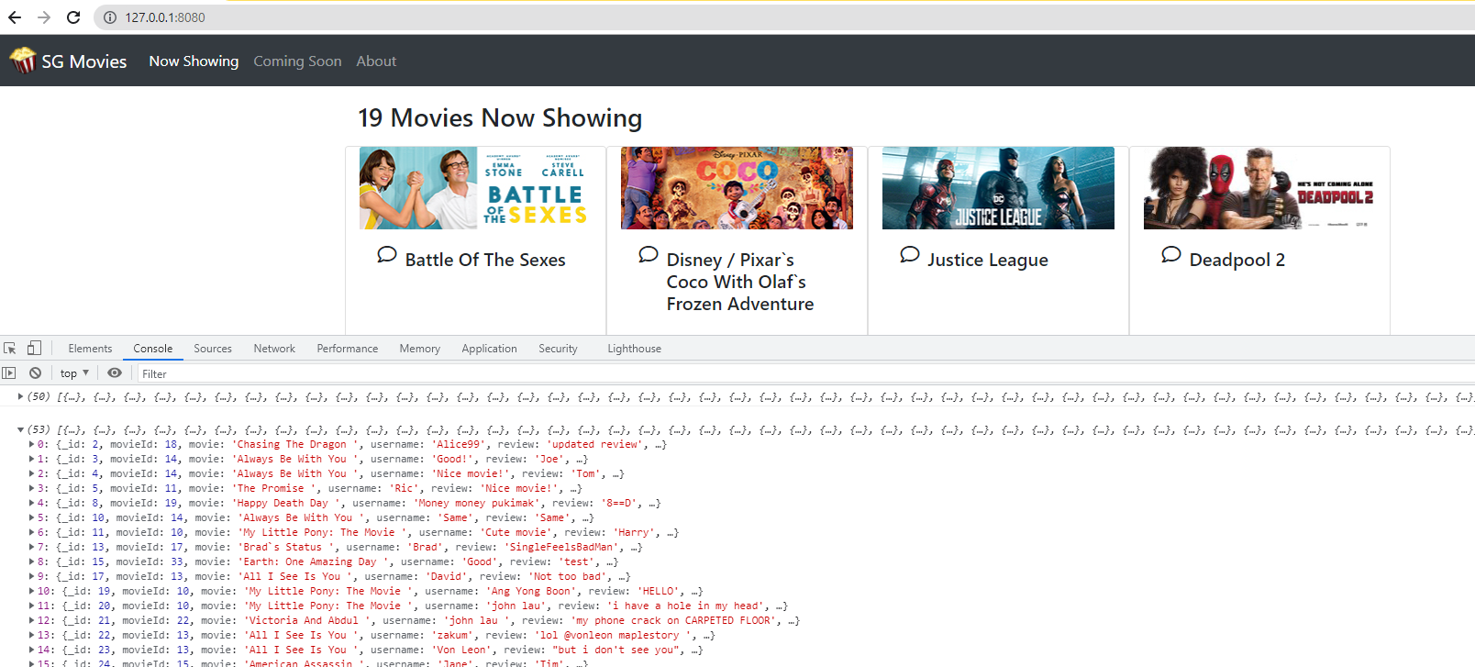
Test the Movie Details Modal Window
You should see the console.log of the comments Array

Slide 17
Adding Comments Modal Window - comments.js
Iterating through the Comments Array and only if the movie selected matches the comments Movie, the item will flow through the IF loop
//This function is to display all the comments of that movie
//whenever the user click on the "comment" button
function showMovieComments(element) {
document.getElementById("emptyComment").innerHTML = "No review yet. Create one now";
var item = element.getAttribute("item");
currentIndex = item;
document.getElementById("review").textContent = "Review for " + movie_array[item].title;
document.getElementById("commentBody").textContent = "";
for (var i = 0; i < comment_array.length; i++) {
if (comment_array[i].movie=== movie_array[item].title) {
document.getElementById("emptyComment").innerHTML = "";
selectedMovieId = movie_array[item]._id;
star = "";
var html = '<div class="text-center" style="width:100%;"> \
<div class="card"> \
<div class="card-body"> \
<p class="card-text" id="rating' + i + '">' + comment_array[i].review + "</p> \
<small>by " + comment_array[i].username + " @ " + comment_array[i].datePosted + "</small> \
</div> \
</div> \
</div>";
document.getElementById("commentBody").insertAdjacentHTML('beforeend', html);
var star = "";
for (var j = 0; j < comment_array[i].rating; j++) {
console.log(i);
star += "<img src='images/popcorn.png' style='width:50px' />";
}
star += "<i class='far fa-trash-alt fa-2x edit' data-dismiss='modal' item='" + i + "' onClick='deleteComment(this)' ></i>";
star += "<i class='far fa-edit fa-2x edit' data-toggle='modal' data-target='#editCommentModal' data-dismiss='modal' item='" + i + "' onClick='editComment(this)' ></i>";
document.getElementById("rating" + i).insertAdjacentHTML('beforebegin', star + "<br/>");
}
}
}

Slide 18
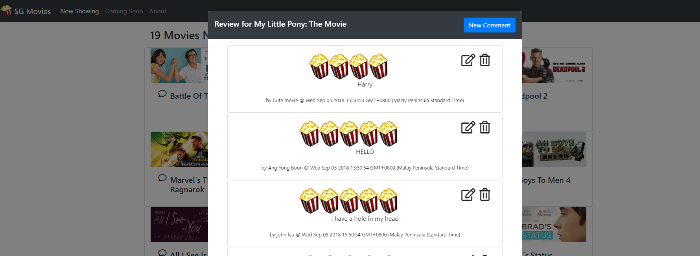
Test the Movie Details Modal Window
Reload the index.html page and hover on one of the movie icons. Click on the “Comments” button and the modal window should appear as shown. Note that some movies may not have comments.

Slide 19
Next Episode…
In the next episode, we will build the modal windows to create and add comments.

Slide 20
The End

